Slide 1
DATA SCIEnCE databases / Mapreduce

Slide 2
I. Databases iI. SQL / Nosql III. mapreduce IV. Implementations of mapreduce V. example of mapreduce
agenda

Slide 3
I. databases
DATA SCIENCE

Slide 4

databases
An organized collection of data
Organized using a schema (like a blueprint of a database)
Organized into tables with different sets of data

Slide 5
databases
Why even USE a database?
Easy to store and more importantly, retrieve data
Generally has a structured language for interacting with the data
Reliable and scalable
Access large amounts of data relatively quickly

Slide 6
databases
Why even USE a database?
Easy to store and more importantly, retrieve data
Generally has a structured language for interacting with the data
Reliable and scalable
Access large amounts of data relatively quickly

Slide 7

databases
How can you visualize a database?

Slide 8
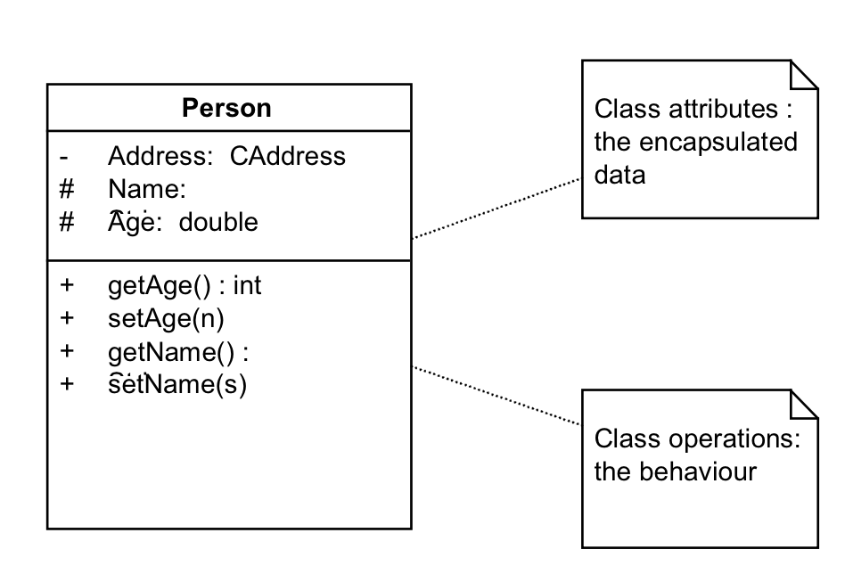
databases

Slide 9
II. SQL / Nosql
DATA SCIENCE

Slide 10
databases
Relational
NoSql
Traditional rows and columns data
Strict structure / Primary Keys
Entire column for each feature
Industry standard
No well defined data structure
Works better for unstructured data
Cheaper hardware
Popular among Startups

Slide 11
databases
Relational
NoSql
Examples
Examples
MySQL
Oracle
Postgres
SQLite
MongoDB
CouchDB
Redis
Casssandra

Slide 12
databases
S
Q
L

Slide 13
databases
Structured
Query
Language
Is a language for database communication

Slide 14
III. mapreduce
DATA SCIENCE

Slide 15
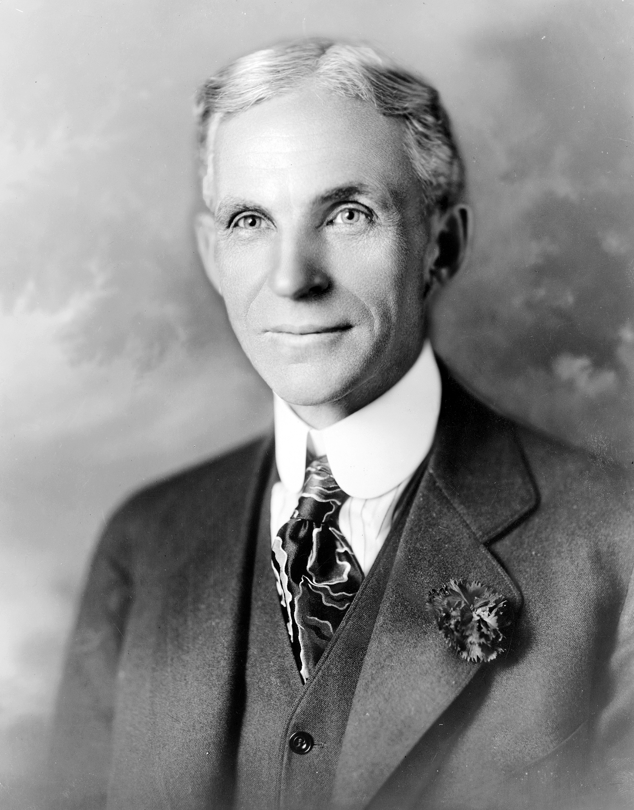
mapreduce
“Nothing is particularly hard if you divide it into small jobs.”
- Henry Ford

Slide 16
mapreduce
MapReduce is broken up into steps:
Map: produces key value pairs depending on the task
Shuffle/Sort sorts the key value pairs, could make new ones
(optional)
3. Reduce combines the key value pairs into a single output

Slide 17

mapreduce
MapReduce is broken up into steps:
Map: produces key value pairs depending on the task
Shuffle/Sort sorts the key value pairs
(optional)
3. Reduce combines the key value pairs into a single output
NOTE
Ideally the map function is run over a cluster of computers in parallel

Slide 18
Mapreduce: Example
Temperatures
Given: several data tables consisting of data organized in a (City: Temperature) over several days
Goal: Find the max temperature for each city
File 1
File 2
New York City: 32
Chicago: 22
New York City: 36
Miami: 67
…
Miami: 77
New York City: 32
New Haven: 29
…

Slide 19
Mapreduce: Example
File 1
New York City: 32
Chicago: 22
New York City: 36
Miami: 67
Chicago: 21
New Haven: 32
File 2
Miami: 77
New York City: 32
New Haven: 29
Chicago: 29
Miami: 78
Chicago: 44

Slide 20
Mapreduce: Example
(NYC: 32,
CHI: 22,
NYC: 36,
MIA: 67,
CHI: 21
NH: 32)
File 1
New York City: 32
Chicago: 22
New York City: 36
Miami: 67
Chicago: 21
New Haven: 32
map
File 2
(MIA: 77,
NYC: 32,
NH: 29
CHI: 29,
MIA: 78,
CHI: 44)
Miami: 77
New York City: 32
New Haven: 29
Chicago: 29
Miami: 78
Chicago: 44
map

Slide 21
Mapreduce: Example
(NYC: 32,
CHI: 22,
NYC: 36,
MIA: 67,
CHI: 21
NH: 32)
File 1
New York City: 32
Chicago: 22
New York City: 36
Miami: 67
Chicago: 21
New Haven: 32
map
(NYC: [32,32,36],
CHI: [21,22,29,44],
MIA: [67,77,78],
NH: [29,32])
sort
File 2
(MIA: 77,
NYC: 32,
NH: 29
CHI: 29,
MIA: 78,
CHI: 44)
Miami: 77
New York City: 32
New Haven: 29
Chicago: 29
Miami: 78
Chicago: 44
map

Slide 22
Mapreduce: Example
(NYC: 32,
CHI: 22,
NYC: 36,
MIA: 67,
CHI: 21
NH: 32)
File 1
New York City: 32
Chicago: 22
New York City: 36
Miami: 67
Chicago: 21
New Haven: 32
map
(NYC: [32,32,36],
CHI: [21,22,29,44],
MIA: [67,77,78],
NH: [29,32])
sort
reduce
File 2
(MIA: 77,
NYC: 32,
NH: 29
CHI: 29,
MIA: 78,
CHI: 44)
Miami: 77
New York City: 32
New Haven: 29
Chicago: 29
Miami: 78
Chicago: 44
map
(NYC: 36,
CHI: 44,
MIA: 78,
NH: 32)

Slide 23
mapreduce
MapReduce Benefits
Extremely scalable: algorithm for a MB of Data will work for a PetaByte of Data
Many implementations with documentation exist for Java, C, Python, etc..
Relatively fast compared tostraight though processing

Slide 24
Mapreduce Example: word count
MECHANICAL TURK ALERT!!!
You are all about to become a MapReduce cluster. All of you will be either a:
Mapper
Sorter
Reducer

Slide 25
Mapreduce Example: word count
(big: 1),
(data: 1),
(big, 1),
(big: 1),
(data: 1)
Mappers
Sorters
Reducer
File 1
big data big big data

Slide 26
Mapreduce Example: word count
(big: 1),
(data: 1),
(big, 1),
(big: 1),
(data: 1)
Mappers
Sorters
Reducer
File 1
big data big big data
(big: 1),
(data: 1),
(big, 1),
(big: 1),
(data: 1),
……..
(big: [1, 1, 1, 1, …]),
(data: [1, 1, 1, … ]),
(sql: [1, 1, 1, …]),
……..

Slide 27
Mapreduce Example: word count
(big: 1),
(data: 1),
(big, 1),
(big: 1),
(data: 1)
Mappers
Sorters
Reducer
File 1
big data big big data
(big: 1),
(data: 1),
(big, 1),
(big: 1),
(data: 1),
……..
(big: [1, 1, 1, 1, …]),
(data: [1, 1, 1, … ]),
(sql: [1, 1, 1, …]),
……..
(big: [1, 1, 1, 1, …]),
(data: [1, 1, 1, … ]),
(sql: [1, 1, 1, …]),
……..
(big: 16),
(data: 22),
(sql: 2),
……..

Slide 28
IV. Implementations of mapreduce
DATA SCIENCE

Slide 29



Implementations of mapreduce
Creator: Apache
Implemented in: Java
Has API for python
Open source
Creator: UC Berkley
Owned by: Apache
Implemented in: Java
Built in API, ML,
Graphing capabilities
Creator: Nokia
Implemented in: Python
Open source on Github

Slide 30
V. example of mapreduce
DATA SCIENCE

